Slide 1
Customer & Marketing Analytics Dashboard
Name: Riya AM
Email:riyashafi51@gmail.com
Tool Used: Tableau
Dataset Source: Customer Sales & Marketing Dataset(Kaggle)

Slide 2
INTRODUCTION
Problem Statement
Dataset Overview
Data Understanding
Data Cleaning & Preparation
Dashboard
Key Insights & Findings
Challenges Faced
Future Improvements
Tools Used
Conclusion

Slide 3
Problem Statement
Understand customer spending behaviour
Identify high-value customers
Measure customer churn
Build a professional dashboard to support business decision-making

Slide 4
Dataset Overview
The dataset contains 15,000 customer records with sales and marketing information
Key Features Used
      Customer ID
      Country
      Acquisition Channel
      Subscription Type
      Device Type
      Signup Date
      Total Revenue
      Average Order Value
      Customer Lifetime Value
      Satisfaction Score
      Churn

Slide 5
Data Understanding
Customers belong to different countries
Device type influences customer activity
Satisfaction score helps measure customer experience
Churn identifies customers who stopped using the service

Slide 6
Data Cleaning & Preparation
Checked for missing values
Removed duplicate records
Corrected data types
Created KPI calculations:
            Total Customers
            Total Revenue
            Average Order Value
            Churn Rate
Added interactive filters

Slide 7
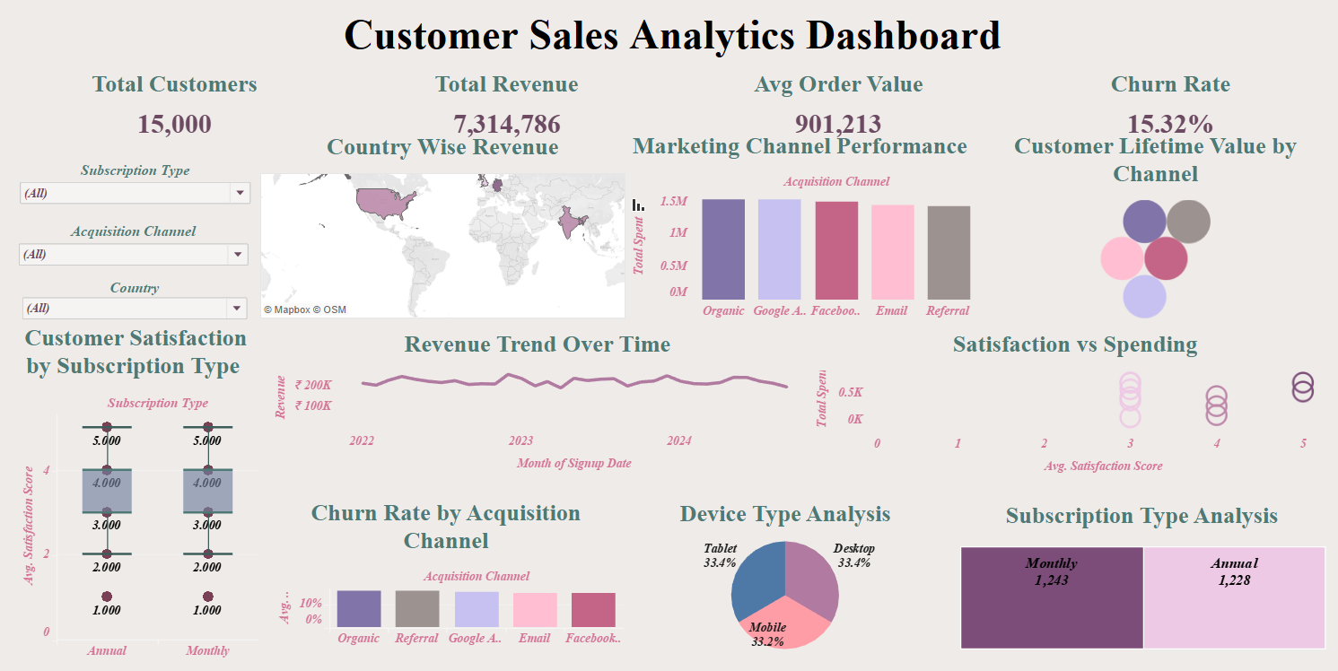

Slide 8
Key Insights & Findings
India and the USA generated high revenue
Marketing channels contribute differently to revenue
Customer satisfaction is generally high
Churn rate is approximately 15%

Slide 9
Challenges Faced
Cleaning and preparing the dataset
Choosing suitable visualizations
Designing a balanced dashboard layout
Implementing interactive filters

Slide 10
Future Improvements
Add predictive sales analysis
include revenue forecasting
Add more KPIs
Use more advanced visuals

Slide 11
Tools Used
Tableau
Microsoft Excel

Slide 12
Conclusion
Understand customer behaviour
Improve marketing strategies
Make data-driven decisions

Slide 13
THANK YOU

